Slide 1




Slide 2

TEST TIME ON CUBES
URL: https://forms.gle/HpnFsrKPWJRUFFkm6
QR CODE:

Slide 3

DATA INTERPRETATION-1

Slide 4
DATA INTERPRETATION
Data Interpretation is one of the most interesting chapter as it deals with real world scenarios where analysis is based on consideration of the data given and analysis.
Questions from this chapter can be based on:
Bar Graph
Line Graph
Pie Chart
Data Table
Notes:
It tests your constraint programming skills

Slide 5
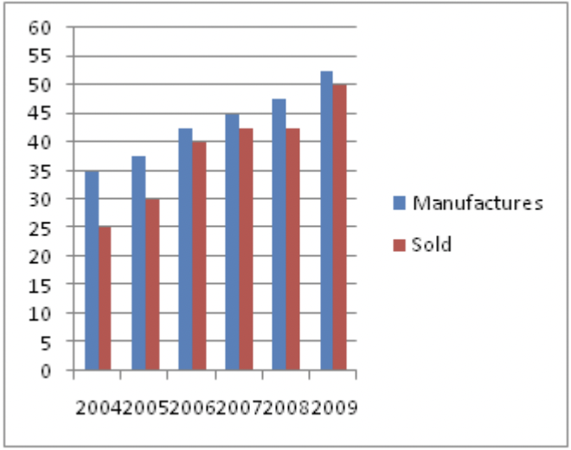
Question: 01
Study the following graph carefully to answer the questions— The following Bar graph gives the number of products manufactured and sold by a company over the years. (in thousands)
What is the difference in the number of products manufactured by the Company in the year 2009 and 2008 ?
5000
5500
3500
4500

Slide 6
Explanation: 01
Difference = 52500 – 47500 = 5000

Slide 7
Question: 02
The number of products sold by the company in the year 2004 is what percent of the number of products manufactured by it in that year ? (Rounded off to two digits after decimal)
71·43
67·51
81·67
56·29

Slide 8
Explanation: 02
Required percentage =( 25/35) X 100 = 71.43 %

Slide 9
Question: 01
Question: 03
What is the percent increase in the number of products manufactured by the company in the year 2006 from the previous year ? (Rounded off to two digits after decimal)
19·25
33·33
10·25
13·33

Slide 10
Explanation:
Explanation: 03
Required percentage = [( 42.5 – 37.5)/(37.5)]X 100= 13.33 %

Slide 11
Question: 04
What is the respective ratio of the number of products not sold by the company in the year 2007 to those not sold in the year 2005 ?
3 : 1
6 : 5
1 : 3
5 : 6
None

Slide 12
Explanation: 04
Required ratio = (45 – 42.5) : (37.5 – 30) = 1 : 3

Slide 13
Question: 05
What is the average number of products manufactured by the company over all the years together ?
36550
39480
41220
43330
34420

Slide 14
Explanation: 05
Required average = (35000 + 37500 + 42500 + 45000 + 47500 + 52500)/6 =43330 (approx).

Slide 15
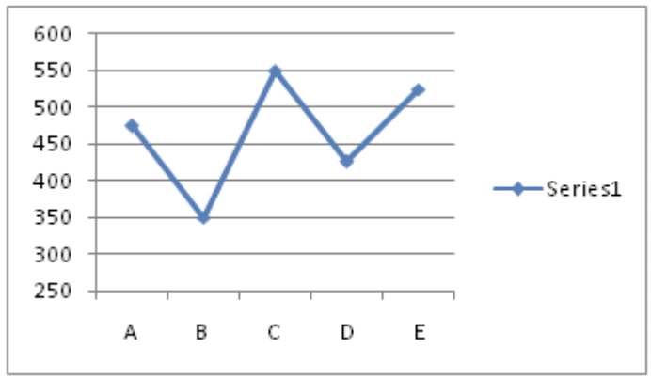
Question: 06
Study the following graph carefully to answer the questions that follow— The following line graph gives distance (in km) travelled by five different trucks in a day.
What is the respective ratio of the distance travelled by Truck A to the distance travelled by Truck D?
17 : 19
11 : 15
19 : 17
15 : 11

Slide 16
Explanation: 06
Required ratio = 475 : 425 = 19 : 17
Notes:
C
It is clear that E = 1 as MAD×E=MAD
From the hundred's line, M + A = 10 + M or 1 + M + A = 10 + M
As A = 10 not possible, A = 9
So I = 0.
and From the thousand's line R + 1 = A. So R = 8.
M 9 D
B 1
-------------
M 9 D
8 9 1
-------------
9 M 0 D
-------------
As B×D = 1, B and D takes 3, 7 in some order.
If B = 7 and D = 3, then M93×7 = _51 is not satisfying. So B = 3 and D = 7.
2 9 7
3 1
-------------
2 9 7
8 9 1
-------------
9 2 0 7
------------

Slide 17
Question: 07
What is the average distance travelled by all the Trucks together ?
510 km
515 km
425 km
465 km

Slide 18
Explanation: 07
Total distance travelled by all trucks = 475 + 350 + 550 + 425 + 525 = 2325 km Average distance = 2325/5 = 465 km .

Slide 19
Question: 08
If Truck C covered the given distance at the average speed of 55 km/hr, what was the time taken by it to cover this distance?
12 hours
10 hours
8 hours
6 hours

Slide 20
Explanation: 08
Time taken by truck C = 550/55 = 10 hours

Slide 21
Question: 02
Question: 09
The distance travelled by Truck A is approximately what percent of the total distance travelled by Truck E and C together ?
44
50
52
58

Slide 22
Explanation:
Explanation: 09
Required percentage =( 475)/ ( 550 + 525) ] X 100 = 44% (approx)

Slide 23
Question: 10
If the time taken by Truck B to cover the given distance was 8 hours, what was the average speed of the truck ?
51·75 km/hr
45·25 km/hr
52·25 km/hr
43·75 km/hr

Slide 24
Explanation:
Explanation: 10
Speed of truck B = 350/8 = 43.75 km/hr

Slide 25
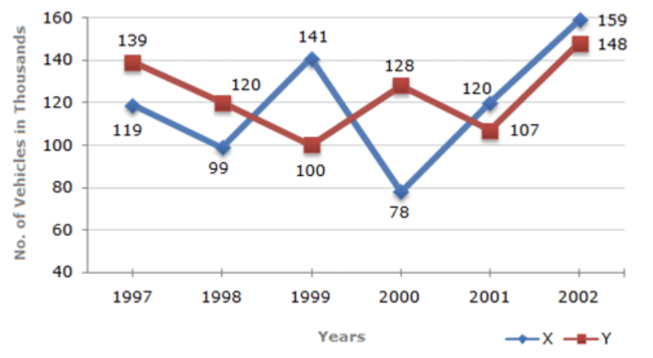
Question: 11
Study the following line graph and answer the questions based on it. Number of Vehicles Manufactured by Two companies over the Years (Number in Thousands)
What is the difference between the number of vehicles manufactured by Company Y in 2000 and 2001?
50,000
42,000
33,000
21,000

Slide 26
Explanation:
Explanation: 11
Required difference = (128000 - 107000) = 21000.

Slide 27
Question: 12
What is the difference between the total productions of the two Companies in the given years ?
19,000
22,000
26,000
28,000

Slide 28
Explanation:
Explanation: 12
From the line-graph it is clear that the productions of Company X in the years 1997, 1998, 1999, 2000, 2001 and 2002 are 119000, 99000, 141000, 78000, 120000 and 159000 and those of Company Y are 139000, 120000,100000, 128000, 107000 and 148000 respectively.
Total production of Company X from 1997 to 2002 = 119000 + 99000 + 141000 + 78000 + 120000 + 159000 = 716000.
and total production of Company Y from 1997 to 2002 = 139000 + 120000 + 100000 + 128000 + 107000 + 148000 = 742000. Difference = (742000 - 716000) = 26000

Slide 29
Question: 13
What is the average numbers of vehicles manufactured by Company X over the given period? (Rounded off to nearest integer)
1, 19, 333
1, 13, 666
1, 12, 778
1, 11, 223

Slide 30
Explanation: 13
Average number of vehicles manufactured by Company X =1/6 *(119000 + 99000 + 141000 + 78000 + 120000 + 159000 = 119333.

Slide 31
Question: 14
In which of the following years, the difference between the productions of Companies X and Y was the maximum among the given years?
1997
1998
1999
2000

Slide 32
Explanation:
Explanation: 14
The difference between the productions of Companies X and Y in various years is:
For 1997 (139000 - 119000) = 20000.
For 1998 (120000 - 99000) = 21000.
For 1999 (141000 - 100000) = 41000.
For 2000 (128000 - 78000) = 50000.
For 2001 (120000 - 107000) = 13000.
For 2002 (159000 - 148000) = 11000.
Clearly, maximum difference was in 2000

Slide 33
Question: 15
The production of Company Y in 2000 was approximately what percent of the production of Company X in the same year?
173
164
132
97

Slide 34
Explanation:
Explanation: 15
Required percentage = [(128000/ 78000) x 100]% = 164%(approx)

Slide 35
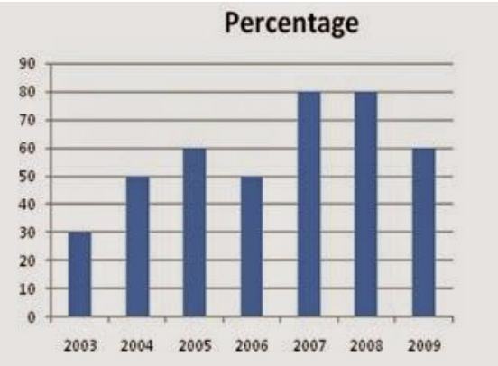
Question: 16
The following line graph gives the percentage of the number of candidates who qualified an examination out of the total number of candidates who appeared for the examination over a period of seven years from 2003 to 2009. Percentage of Candidates Qualified to Appeared in an Examination Over the Years
If the number of students appeared in the examination in 2004 and 2005 were in the ratio 2 : 3, then find the ratio of qualified students from these years?
2: 3
5: 6
4: 5
5:9

Slide 36
Explanation:
Explanation: 16
Required ratio = 50% of 2 : 60% of 3 = 5 : 9.

Slide 37
Question: 17
If the number of candidates qualified in 2007 was 5800, what was the number of candidates appeared in 2007?
7520
7250
7500
72500

Slide 38
Explanation:
Explanation: 17
Required number = 5800/0.8 = 7250

Slide 39
Question: 18
If the total number of candidates appeared in 2005 and 2006 together was 42400, then the total number of candidates qualified in these two years together was?
34700
32100
31500
Can’t be determined
Notes:
D

Slide 40
Explanation:
Explanation: 18
Since we don’t know the number of candidates appeared in 2005 and 2006 individually, we cannot find the number of qualified candidates.

Slide 41
Question: 19
The total number of candidates qualified in 2008 and 2009 together was 6600 and the number of candidates appeared in 2008 was 5100. What was the number of candidates appeared in 2009?
4000
4850
4200
4150

Slide 42
Explanation:
Explanation: 19
Let the number of candidates appeared in 2009 was x. Then 80% of 5100 + 60% of x = 6600 x = 4200

Slide 43

https://learn.codemithra.com

Slide 44




THANK YOU
+91 78150 95095
codemithra@ethnus.com
www.codemithra.com

